Slide 1
Product demo

Slide 2

OBJECTIVES FOR THIS SESSION
Get the most out of an event
Practice product demo

Slide 3



DISCUSSION
National Career Forum’s review
15 MIN
What did you do & who did you meet?
What are your positive impressions about this event?
How to improve your preparation for next event?

Slide 4
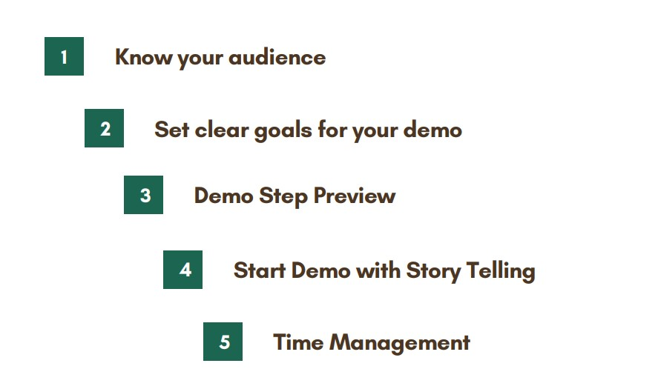
How to demo a product to a client?
EXPLAIN
10 MIN

Slide 5

EXPLAIN
Steps for product demo
Strong introduction
Focus on the benefits
Demonstrate the product
Address objections
End with a call-for-action

Slide 6


Pitch competition!
ACTIVITY 1
60 MIN
Your team is presenting a new product in the competition:
Best Website Award!
The award will go to the team who presented their website the most effectively.
Read your product brief and prepare your presentation!
1
PREPARATION
(30 min)
2
PRESENTATIONS
(5x5 min)
3
VOTE
(5 min)
TO COMPLETE THIS ACTIVITY :

